Slide 1
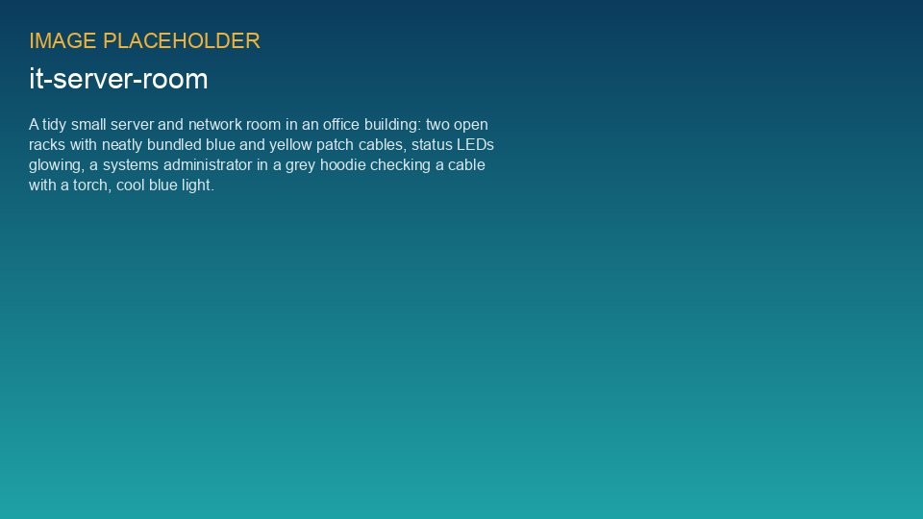
WEYLAND ENERGY
ISO 27001 programme
Steering committee · 29 September 2026

Slide 2
Where we stand
2027
68 %
100 %
61 %
Q2 certification target – on track
controls implemented
MFA coverage
phishing report rate
WEYLAND ENERGY · ISO 27001 Steering Committee – September 2026
2

Slide 3
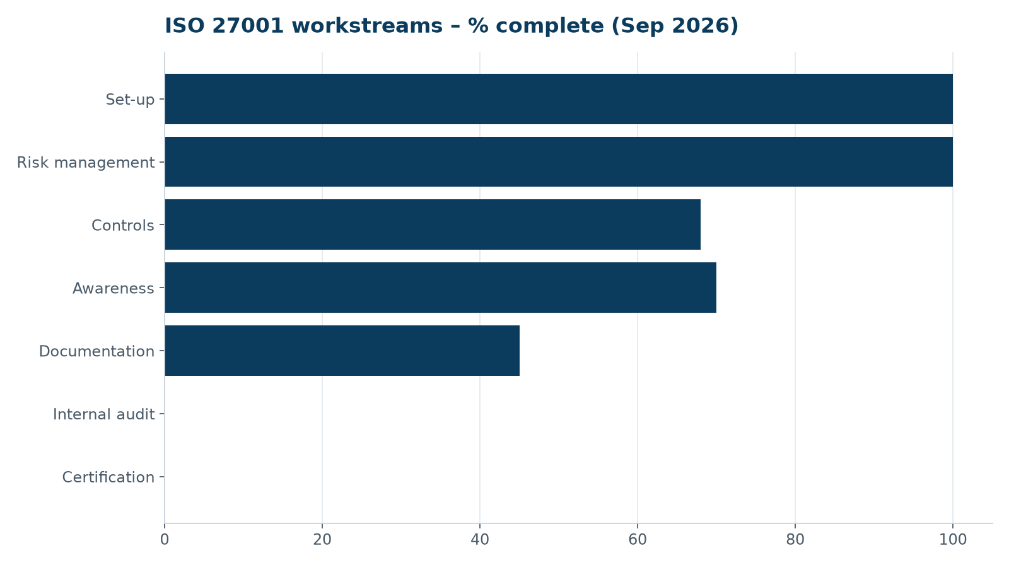
Progress by workstream
WEYLAND ENERGY · ISO 27001 Steering Committee – September 2026
3

Slide 4
Highlights since June
• Privileged access management live (tiered admin accounts)
• Quarterly restore test passed – 4 h 10 min for the full Finance share
• Certification body selected: NordCert GmbH (stage 1 in March 2027)
• File services migration pilot (IT, HR, Handbook) completed successfully
WEYLAND ENERGY · ISO 27001 Steering Committee – September 2026
4

Slide 5
Risks and issues
Issue | Impact | Action
OT firewall delivery for Kestrel Ridge delayed 4 weeks | Control 8.22 late | Interim ACLs, install 27 Nov
Supplier questionnaires: 7 of 24 outstanding | 5.19–5.22 evidence | Escalation via Legal
Workload IT team during migration waves | Documentation backlog | Northlight support days
WEYLAND ENERGY · ISO 27001 Steering Committee – September 2026
5

Slide 6
Decisions needed
• Approve OpenCloud enterprise support subscription (WE-CON-2026-029)
• Nominate department ISMS champions (one per department)
• Confirm internal audit dates 16 Nov 2026 – 29 Jan 2027
WEYLAND ENERGY · ISO 27001 Steering Committee – September 2026
6
Notes:
Priya confirms DPA is final; Jonas to sign the subscription once the board approves.

Slide 7
WEYLAND ENERGY
Thank you
Katarzyna Nowak · IT & Security Lead

